Slide 1
Mottled Stars - Methodology
How Does Starspot Coverage Affect Stellar Brightness Variability?
Miles L. Johnson, Gregory A. Feiden

Slide 2
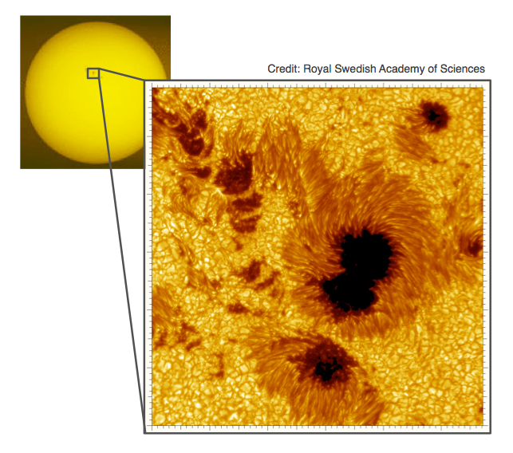
Mottled Stars
Starspots can cause either superficial changes to the observable properties of a star or cause deep structural changes
To understand this process, we investigate how starspots affect a star’s brightness over time
Starspots are observed to be cooler than the background photosphere
Therefore, they emit some fraction of the photons that the ambient photosphere emits

Slide 3
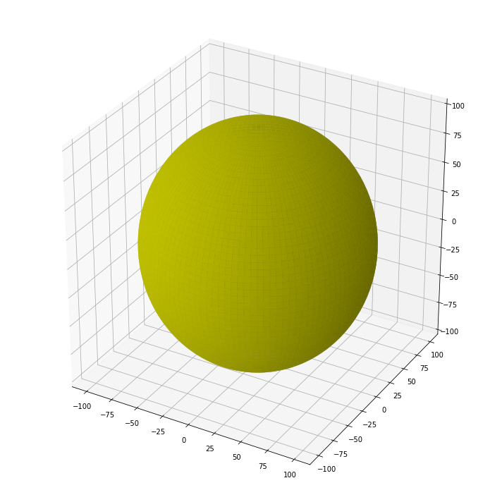
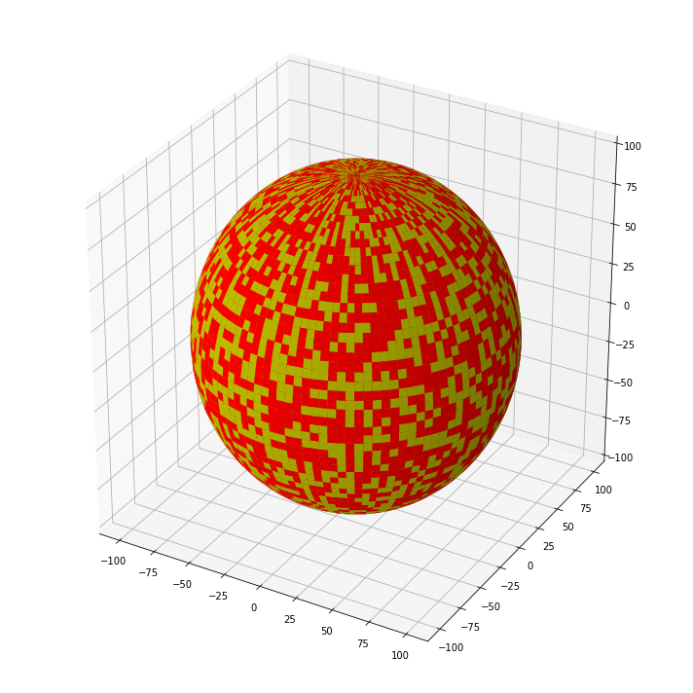
Building 3-D Stellar Models
We created three-dimensional model sphere in our preferred programming language
Code was written that randomly selected cells to be ‘spot cells’ at any given surface coverage
To calculate the observed luminosity of our stellar model, we projected the observed hemisphere of our model onto a square

Slide 4
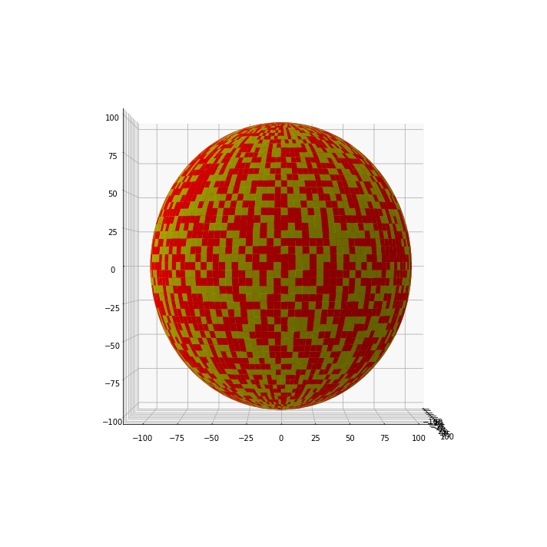
3-D Model to 2-D Projection
A projection was chosen that preserves apparent surface area
Surface area is directly proportional to luminosity
Cells on the edges of the observed hemisphere have a smaller apparent surface area
Therefore, we observe the edges of the observed hemisphere to be dimmer than the center

Slide 5
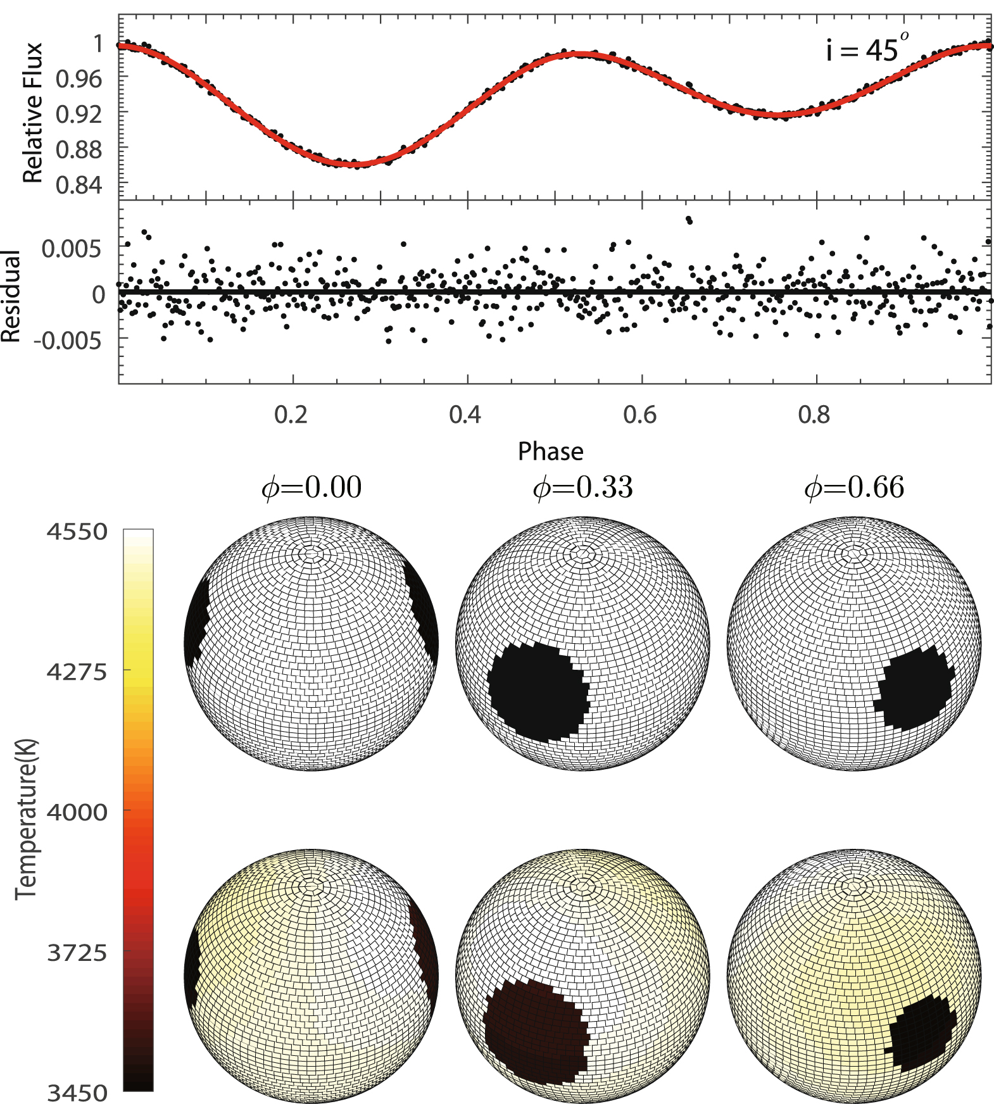
Luminosity Integration
To simulate changes in luminosity in our models as a function of time, the stellar model would be rotated
With each discrete rotation, a new projection of the observed hemisphere is produced
After a complete rotation, the observed luminosity from each projection is summed, and plotted against rotational angle
This is known as a light curve
Image Credit: Lou et al. (2019)

Slide 6
References
Gough, D. (2010). Vainu Bappu Memorial Lecture: What is a Sunspot? Cambridge, UK. Institute of Astronomy, University of Cambridge, U.K.
Kutner, M. (2003). Astronomy : a physical perspective. Cambridge, U.K. New York: Cambridge University Press.

